Slide 1

MSHN Priority Measures
FY24 Q4
Reporting Period: 10/1/23 – 9/30/24

Slide 2
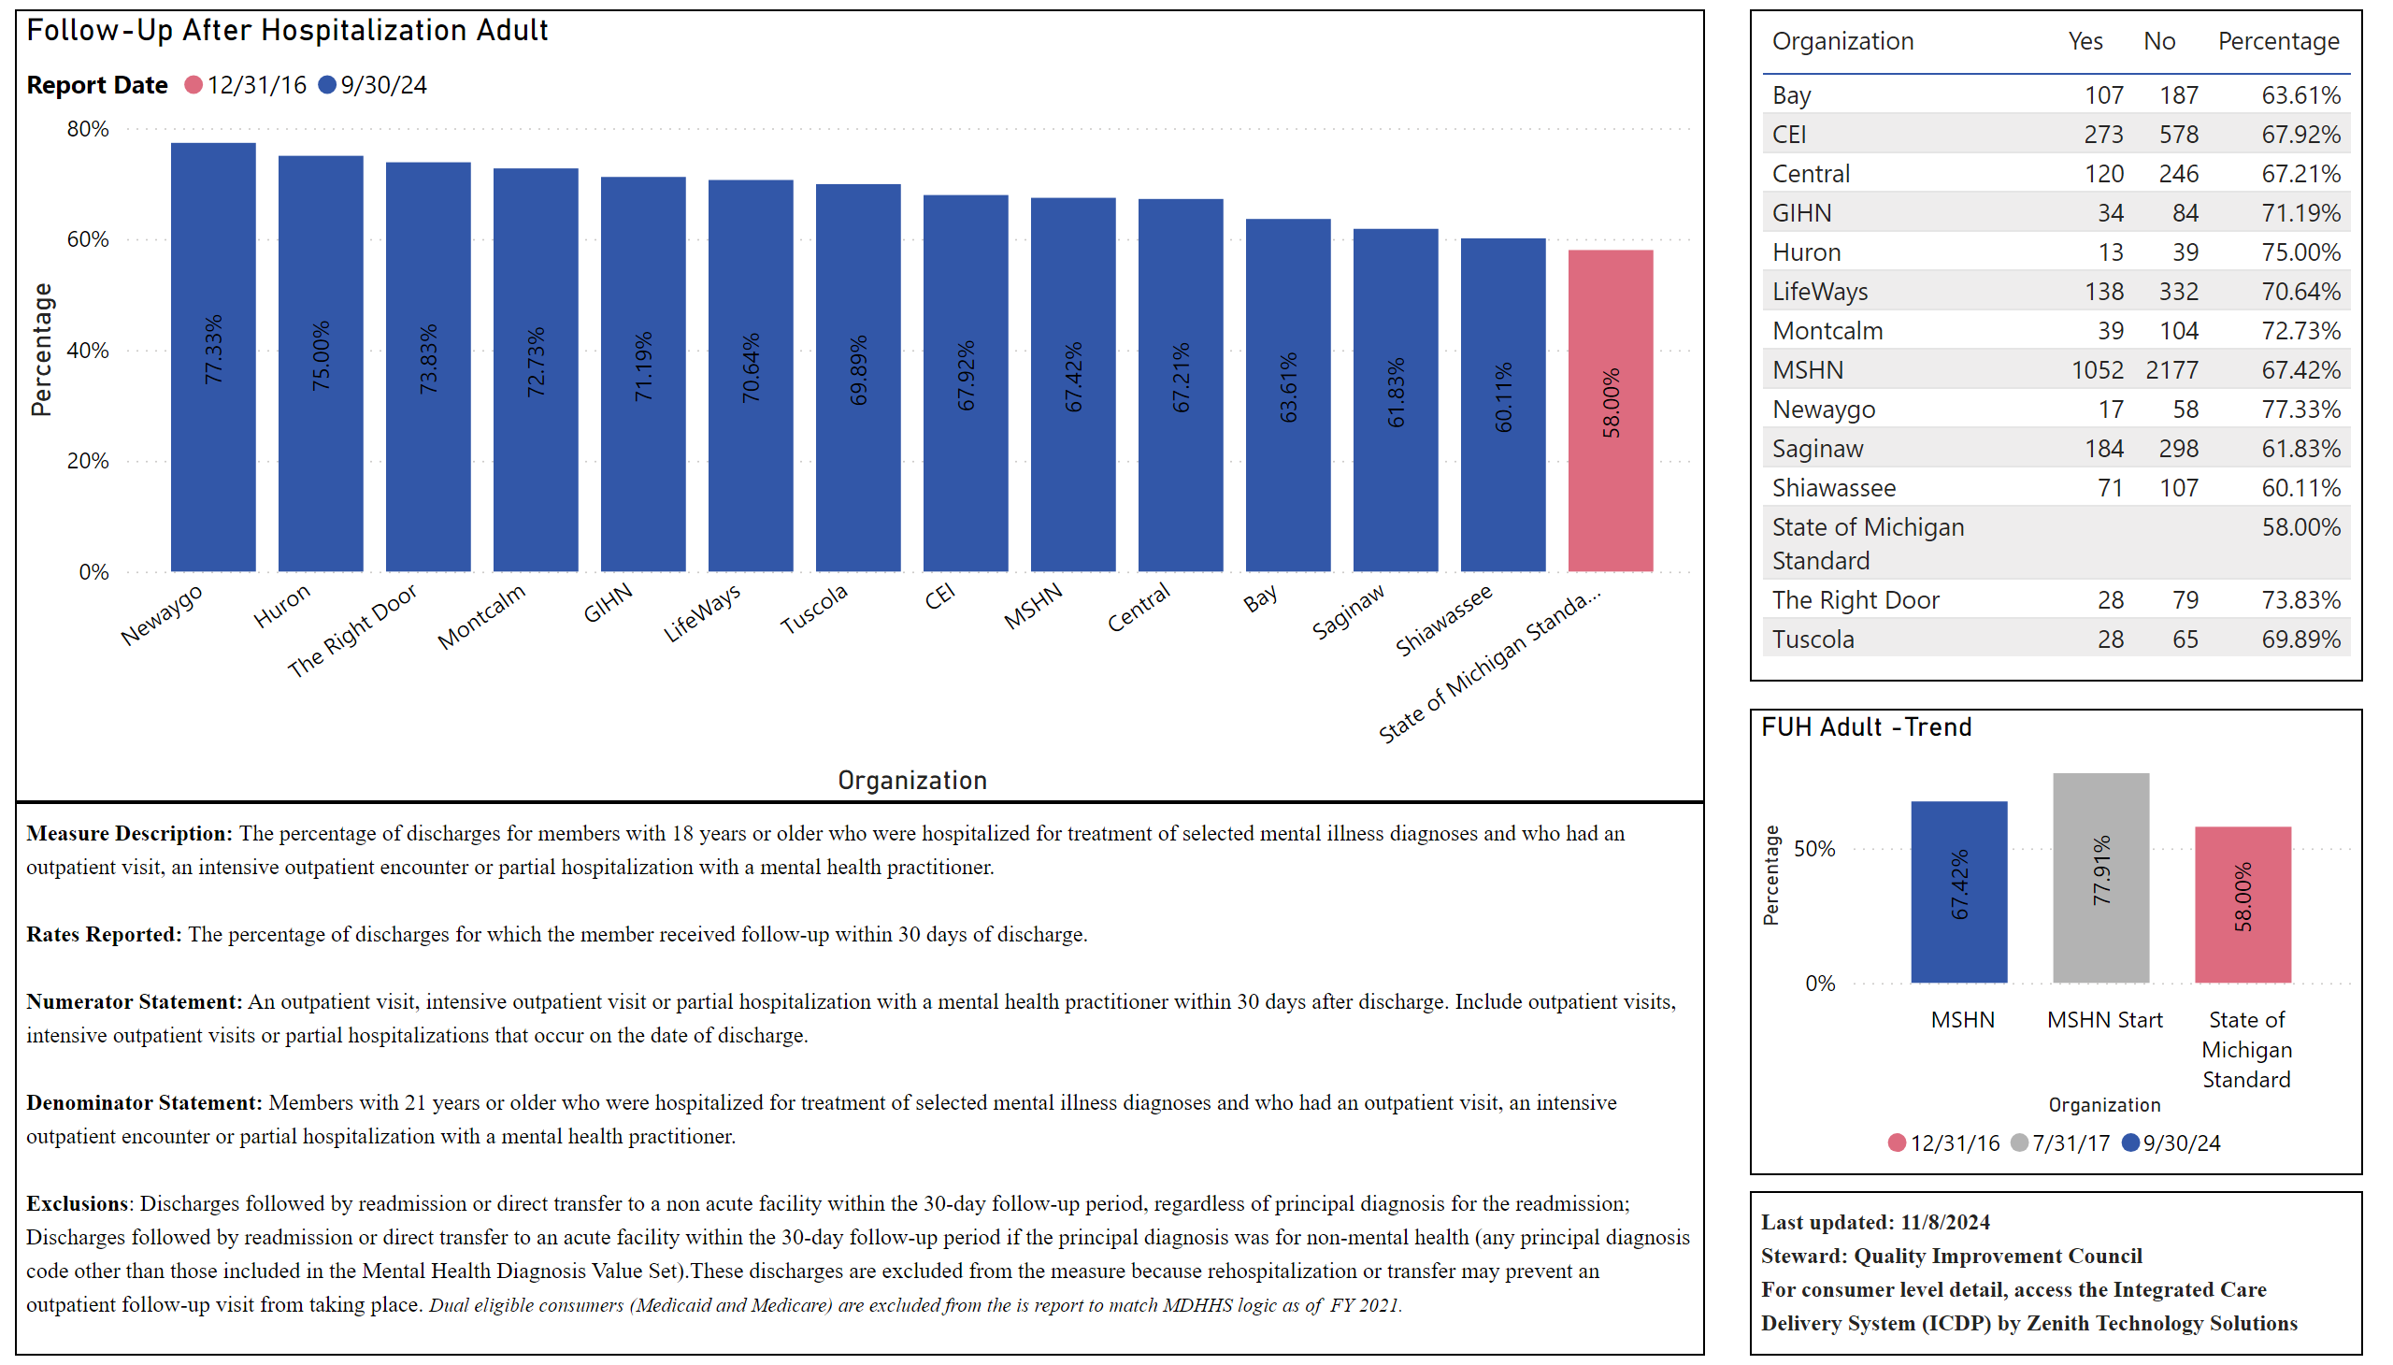
Follow-Up After Hospitalization - Adult
Notes:
Follow-Up After Hospitalization Adult
No alt text provided
tableEx
No alt text provided
textbox
No alt text provided
FUH Adult -Trend
No alt text provided
textbox
No alt text provided

Slide 3
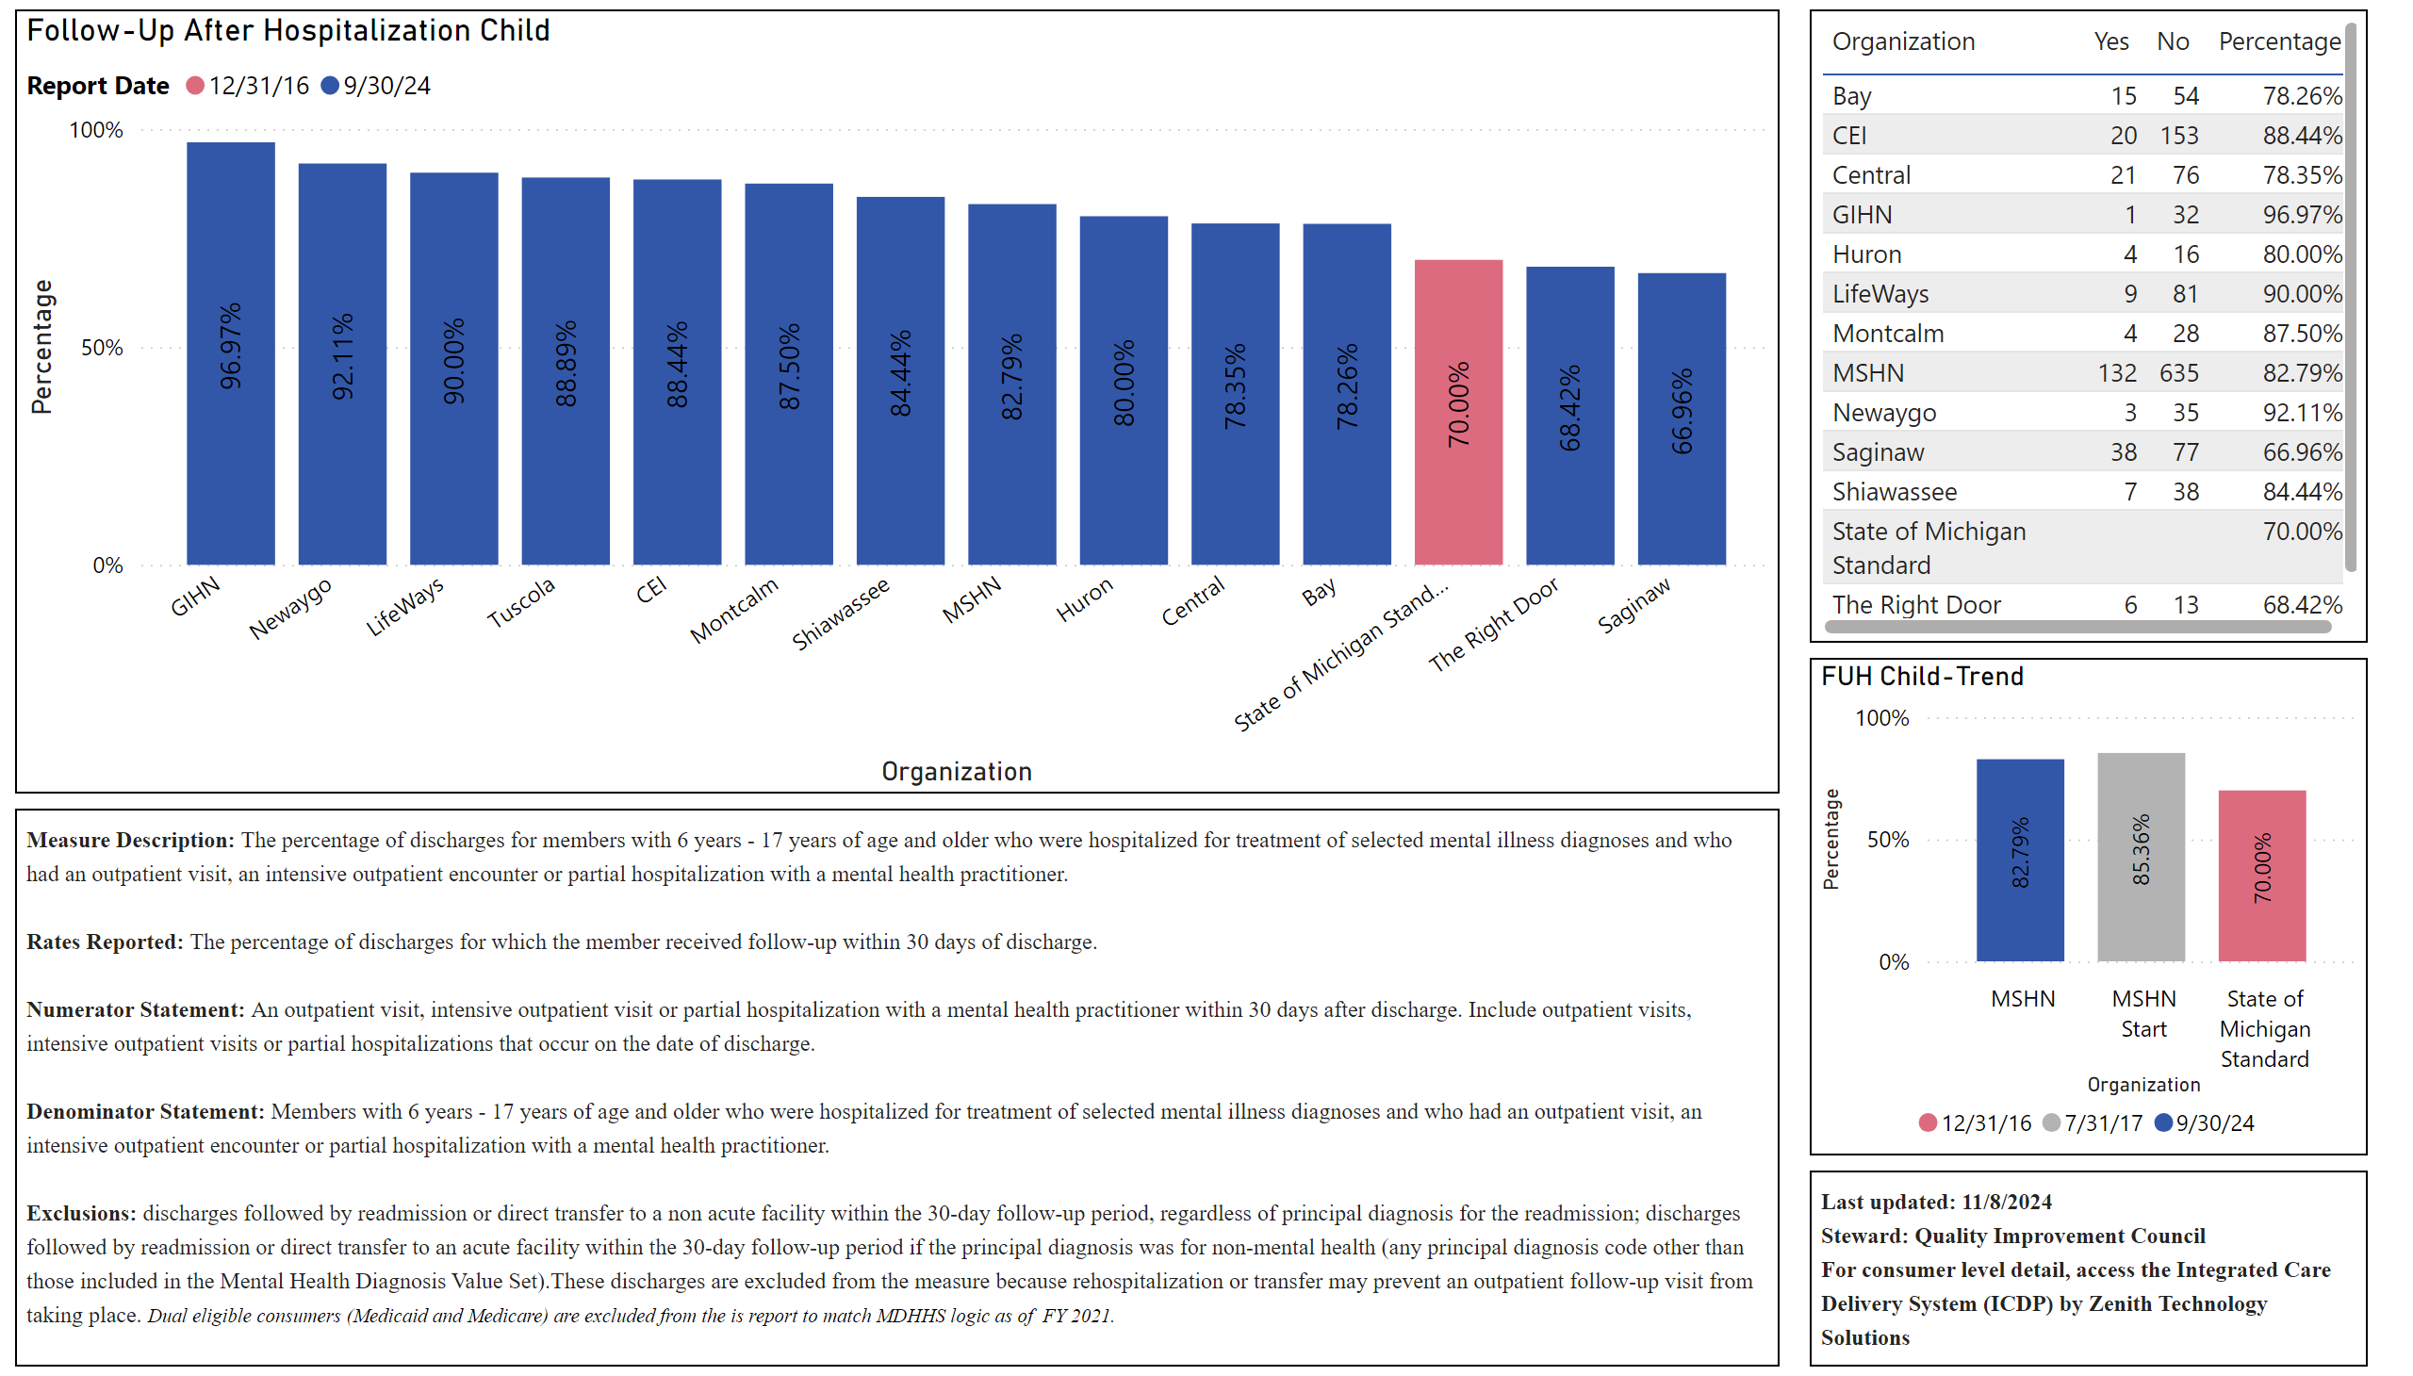
Follow-Up After Hospitalization - Child
Notes:
Follow-Up After Hospitalization Child
No alt text provided
tableEx
No alt text provided
textbox
No alt text provided
FUH Child-Trend
No alt text provided
textbox
No alt text provided

Slide 4
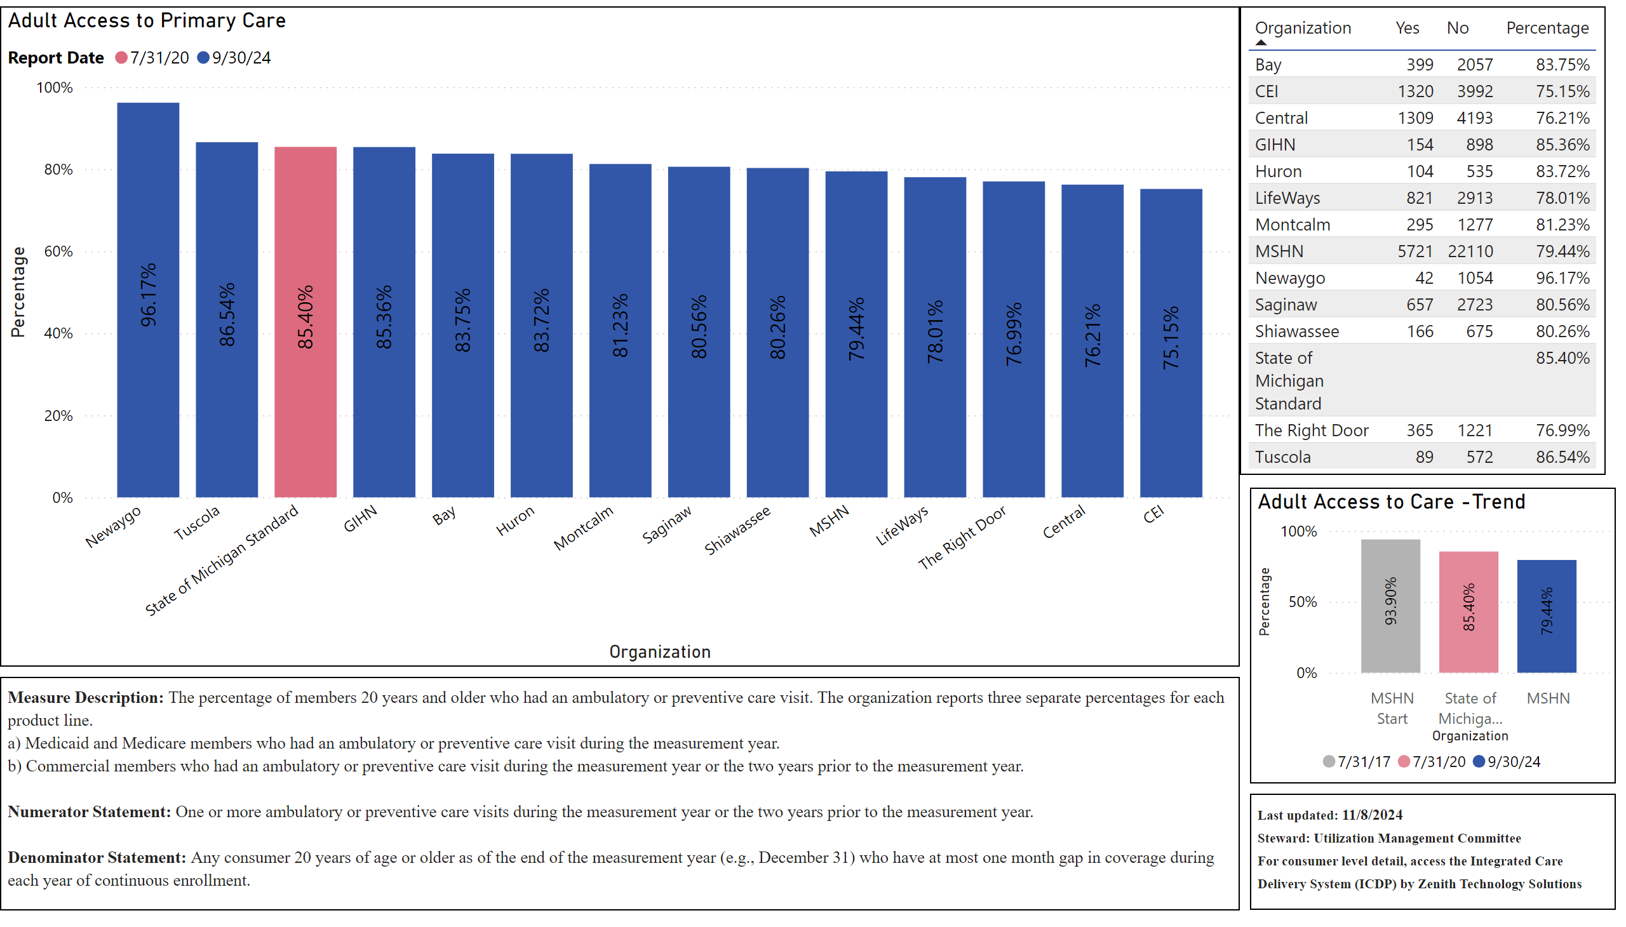
Adult Access to Care
Notes:
Adult Access to Primary Care
No alt text provided
tableEx
No alt text provided
Adult Access to Care -Trend
No alt text provided
textbox
No alt text provided
textbox
No alt text provided

Slide 5
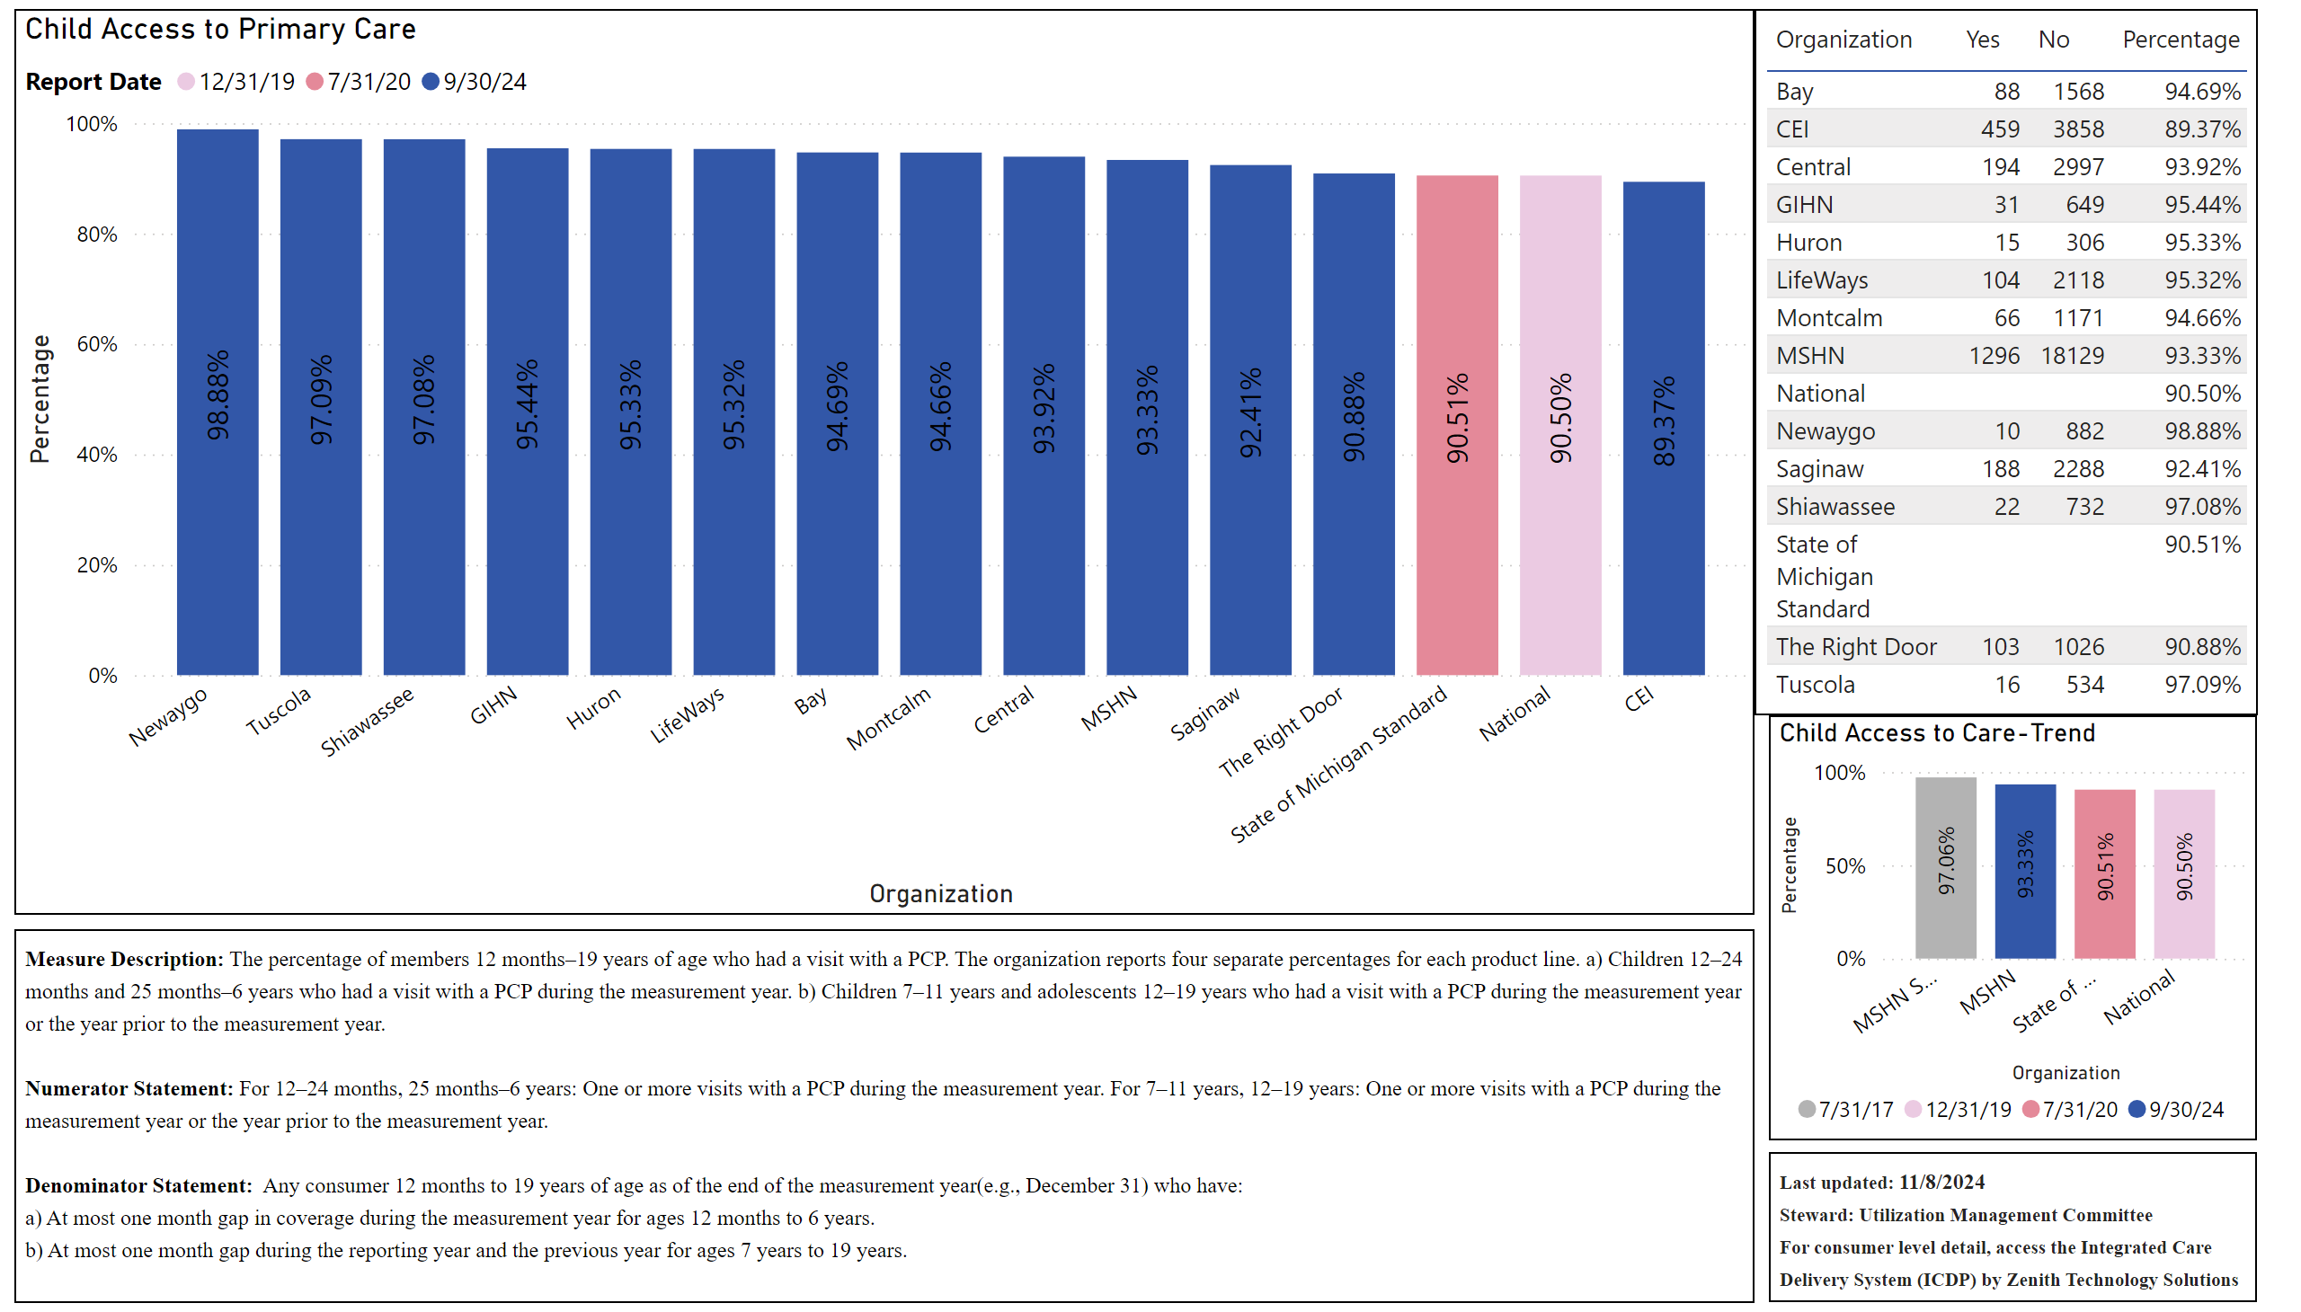
Child Access to Care
Notes:
Child Access to Primary Care
No alt text provided
textbox
No alt text provided
tableEx
No alt text provided
Child Access to Care-Trend
No alt text provided
textbox
No alt text provided

Slide 6
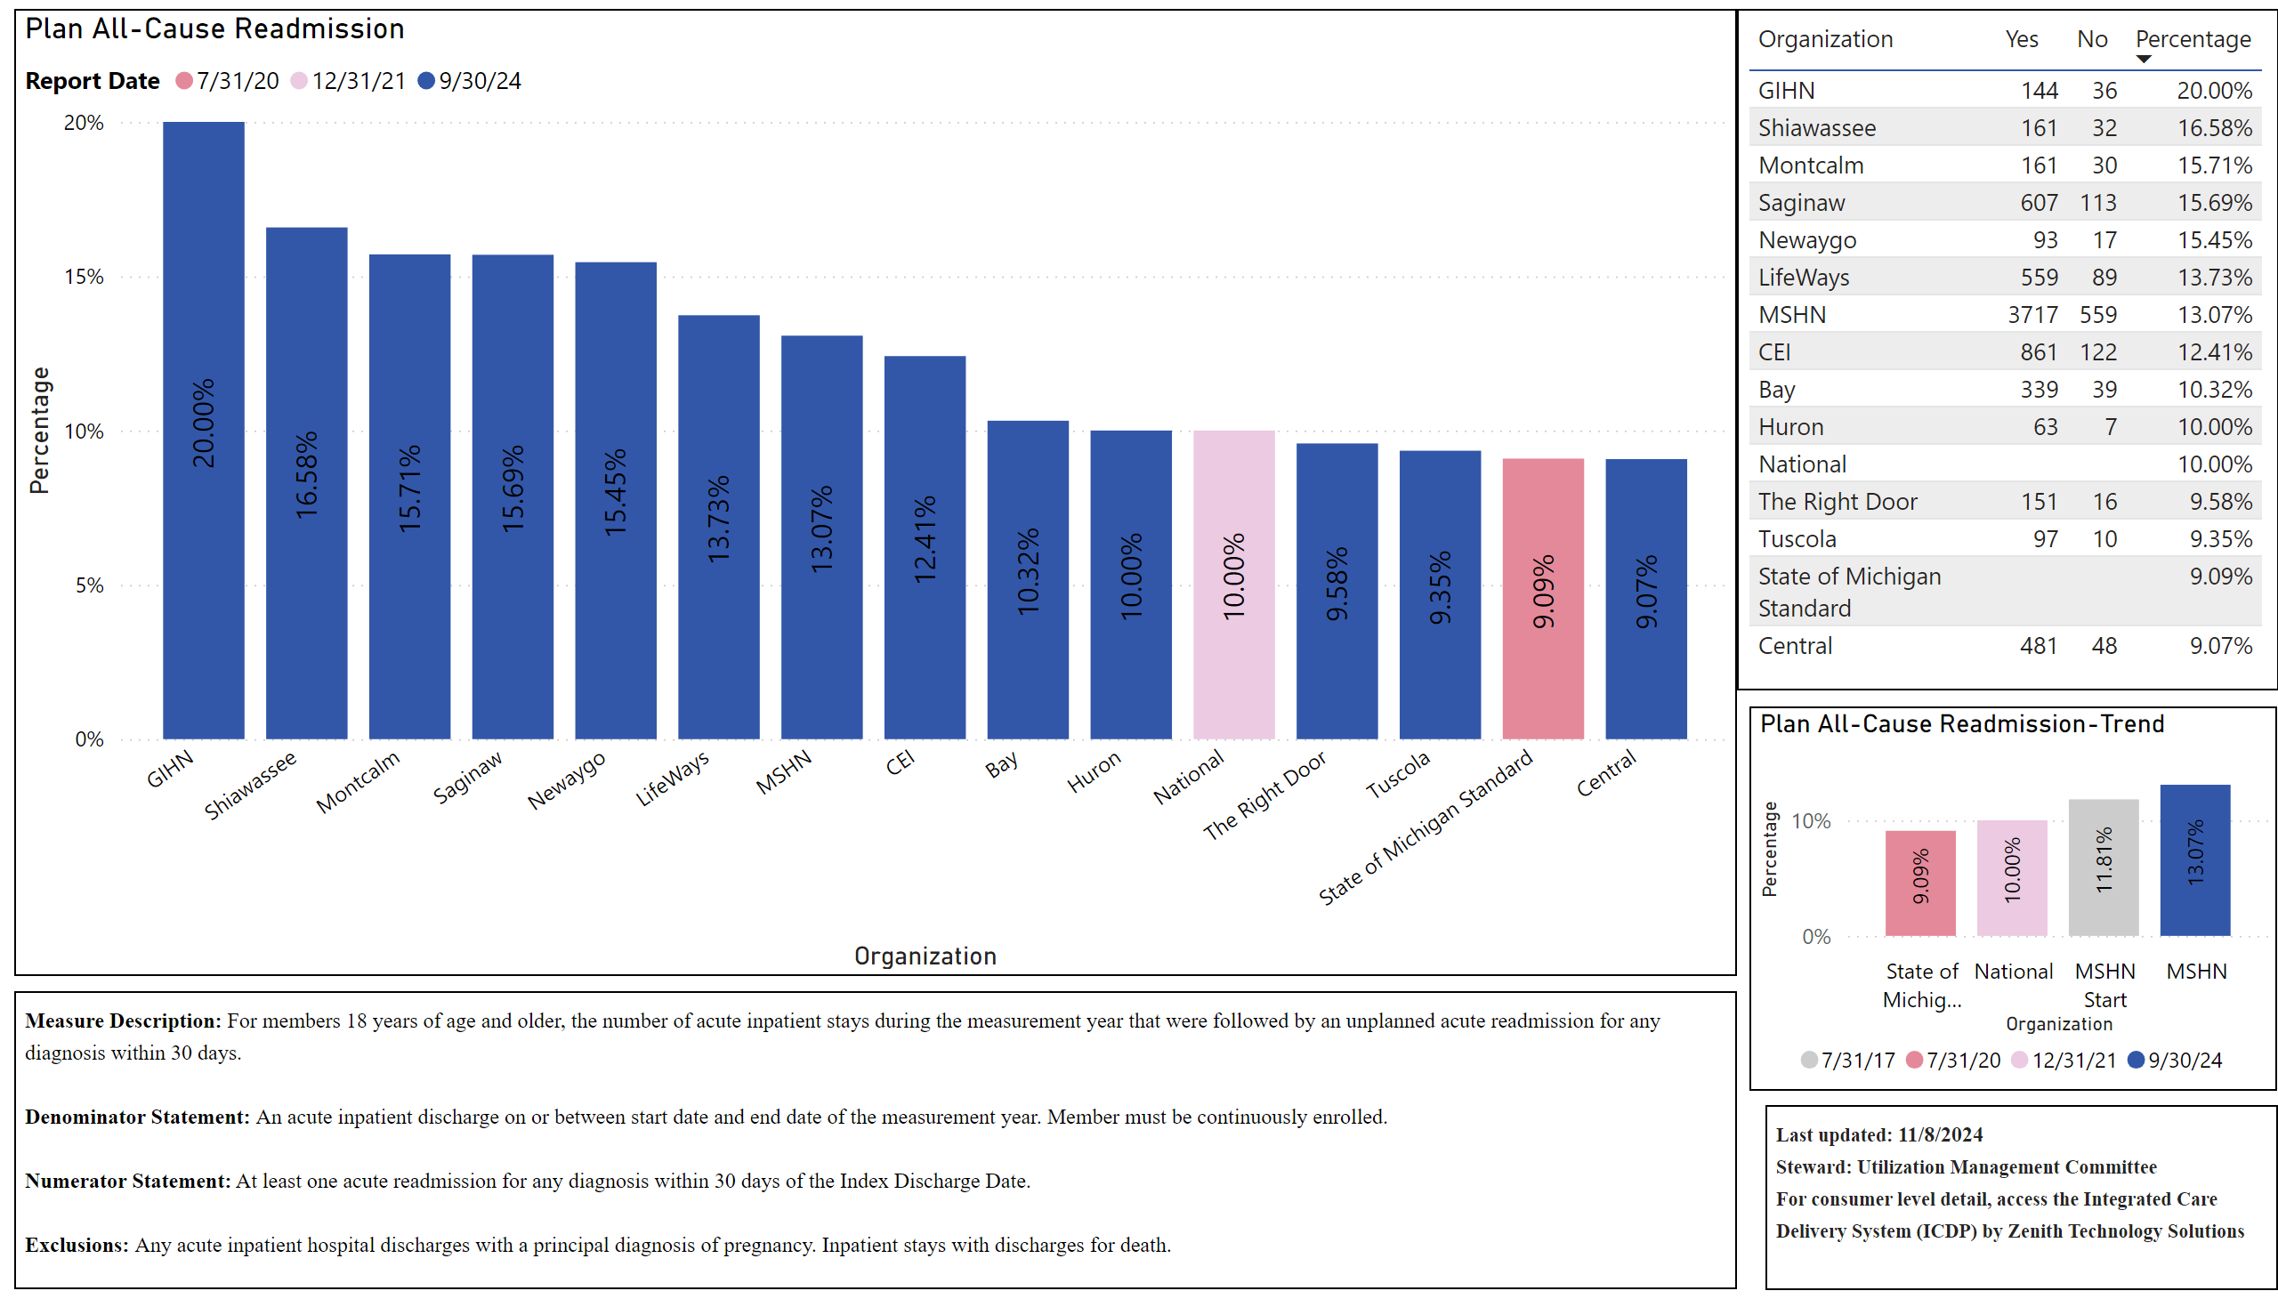
Plan All-Cause Readmission
Notes:
Plan All-Cause Readmission
No alt text provided
textbox
No alt text provided
tableEx
No alt text provided
Plan All-Cause Readmission-Trend
No alt text provided
textbox
No alt text provided

Slide 7
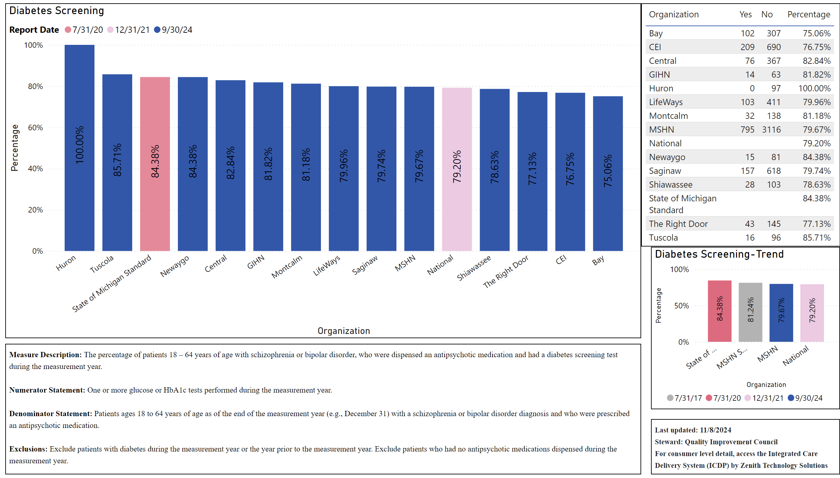
Diabetes Screening
Notes:
Diabetes Screening
No alt text provided
tableEx
No alt text provided
Diabetes Screening-Trend
No alt text provided
textbox
No alt text provided
textbox
No alt text provided

Slide 8
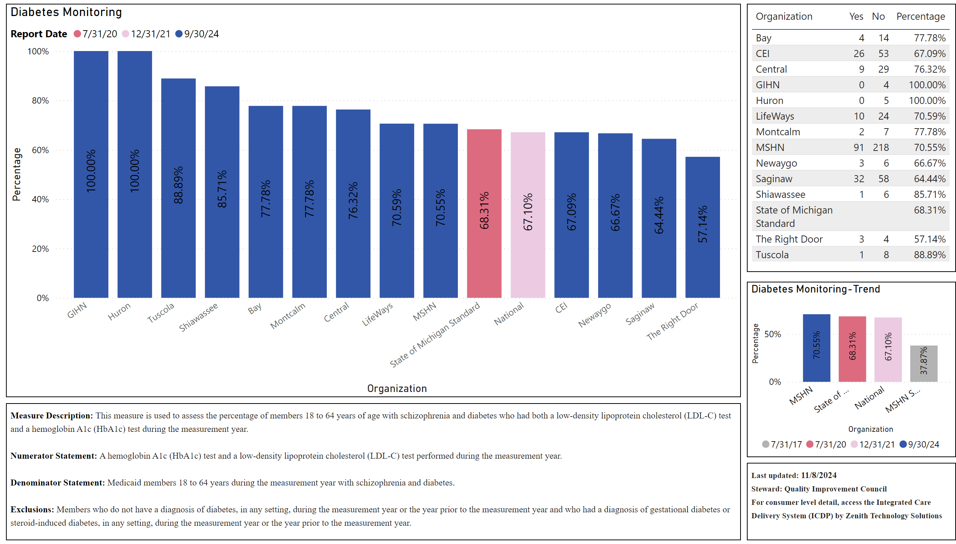
Diabetes Monitoring
Notes:
Diabetes Monitoring
No alt text provided
tableEx
No alt text provided
textbox
No alt text provided
Diabetes Monitoring-Trend
No alt text provided
textbox
No alt text provided

Slide 9
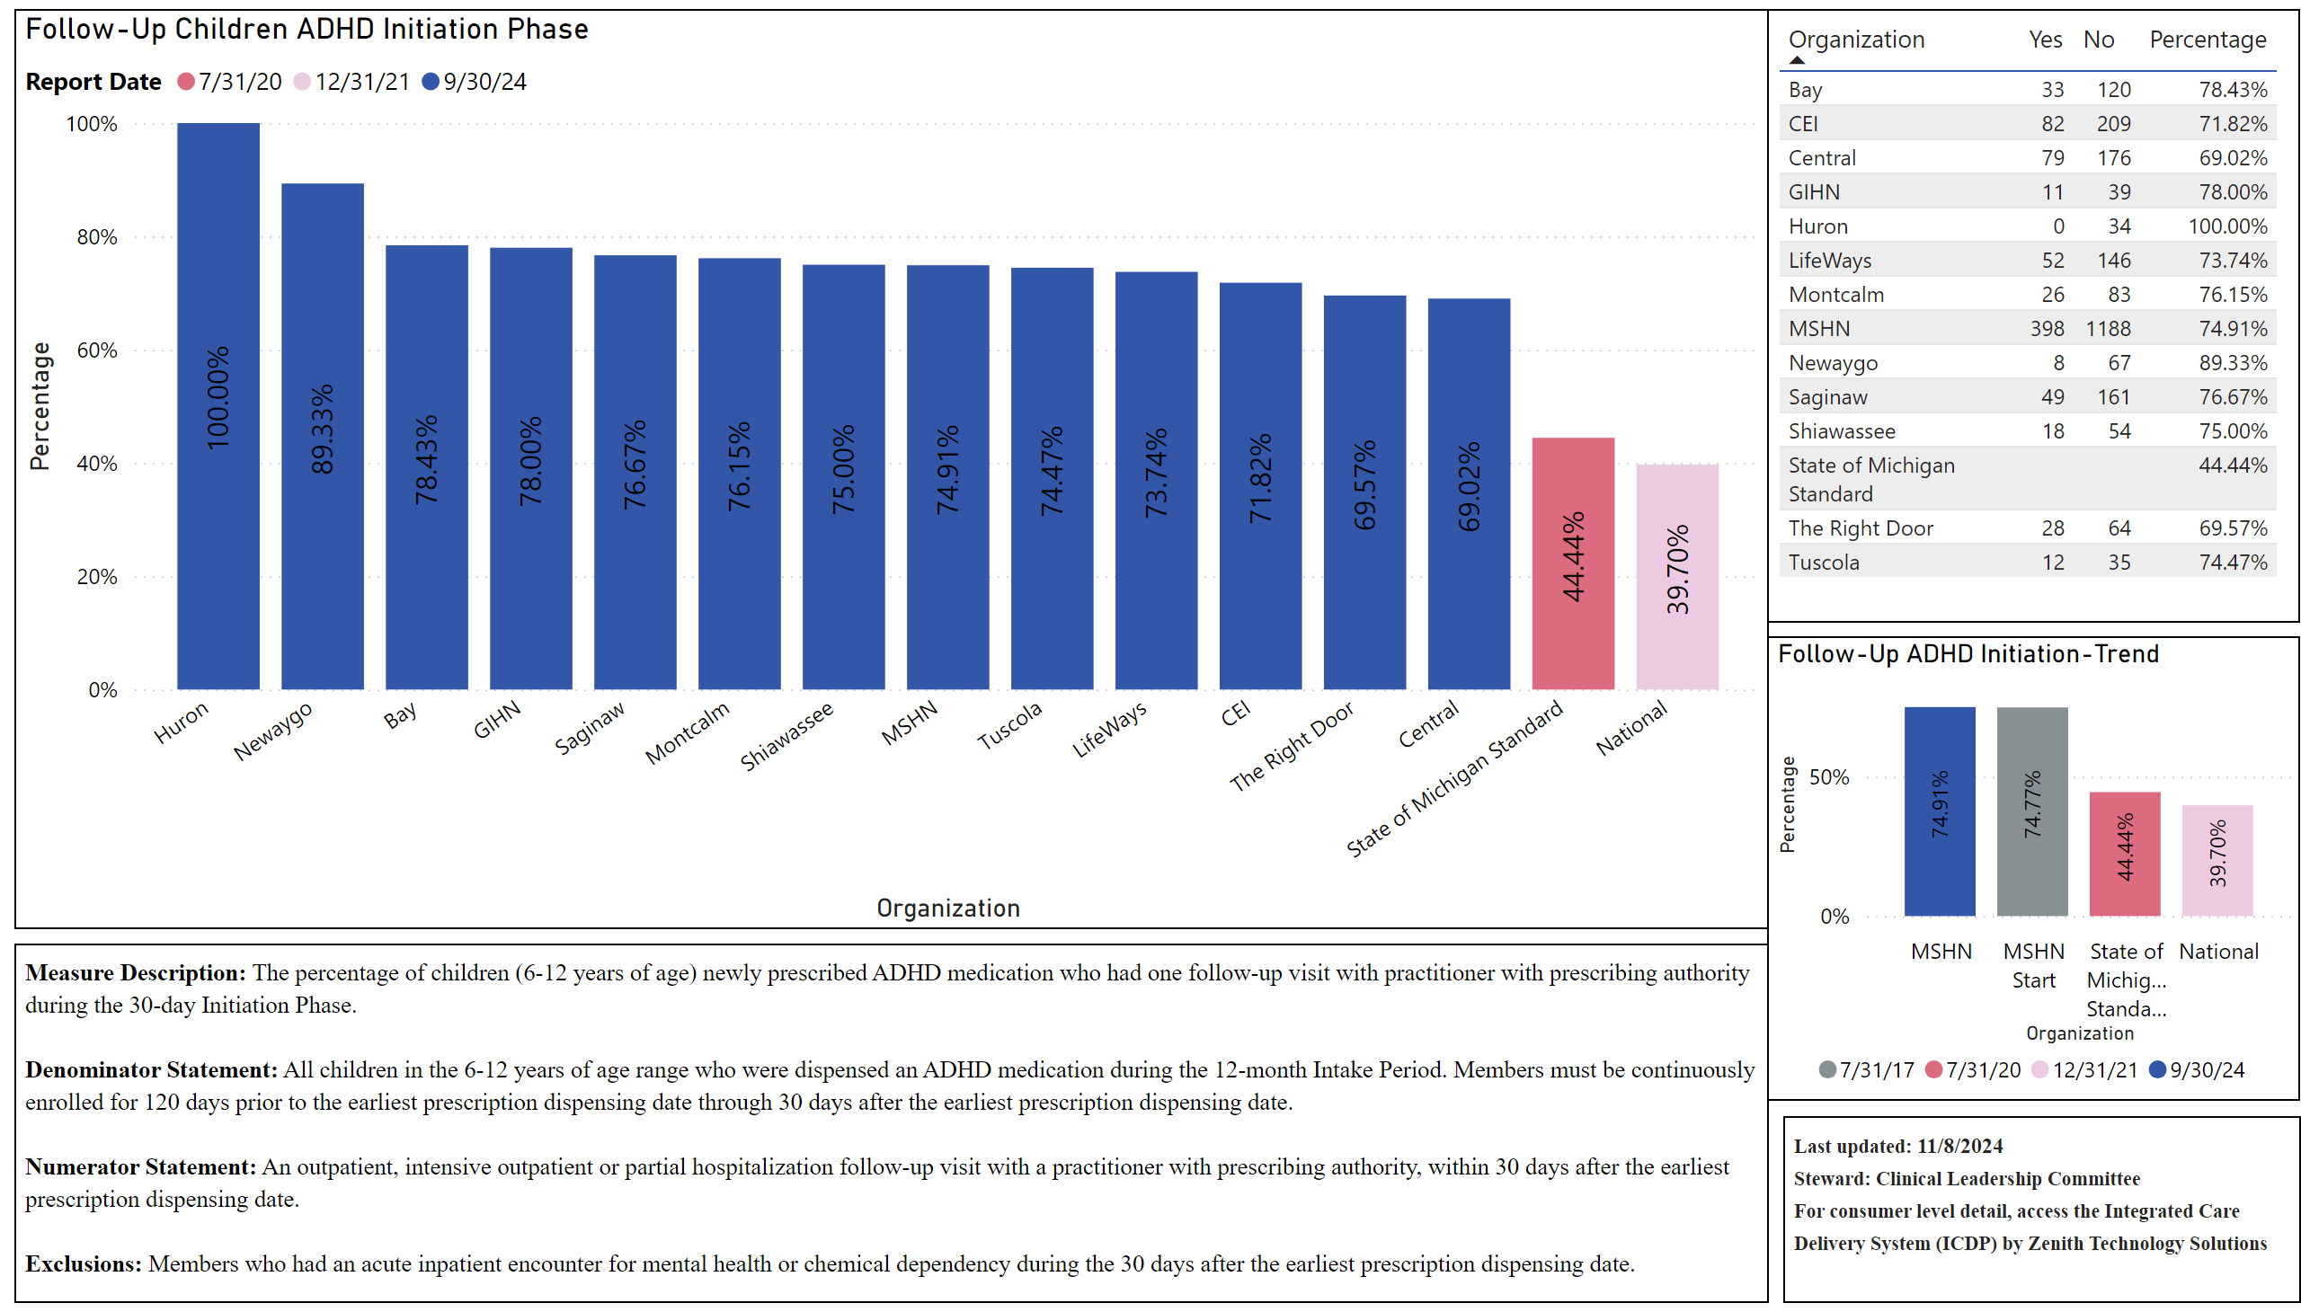
Follow-Up Children ADHD Initiation Phase
Notes:
Follow-Up Children ADHD Initiation Phase
No alt text provided
tableEx
No alt text provided
Follow-Up ADHD Initiation-Trend
No alt text provided
textbox
No alt text provided
textbox
No alt text provided

Slide 10
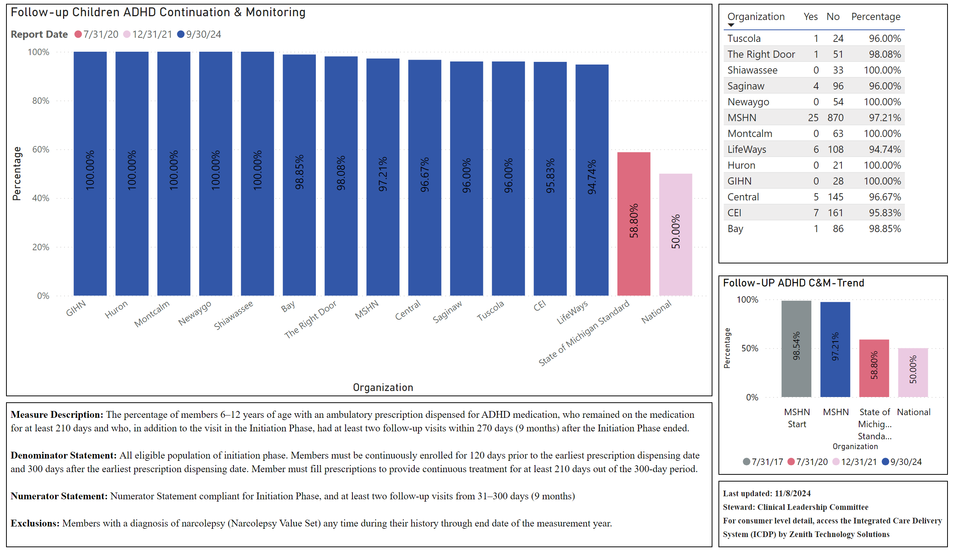
Follow-Up Children ADHD Continuation & Monitoring Phase
Notes:
Follow-up Children ADHD Continuation & Monitoring
No alt text provided
Follow-UP ADHD C&M-Trend
No alt text provided
textbox
No alt text provided
textbox
No alt text provided
tableEx
No alt text provided

Slide 11
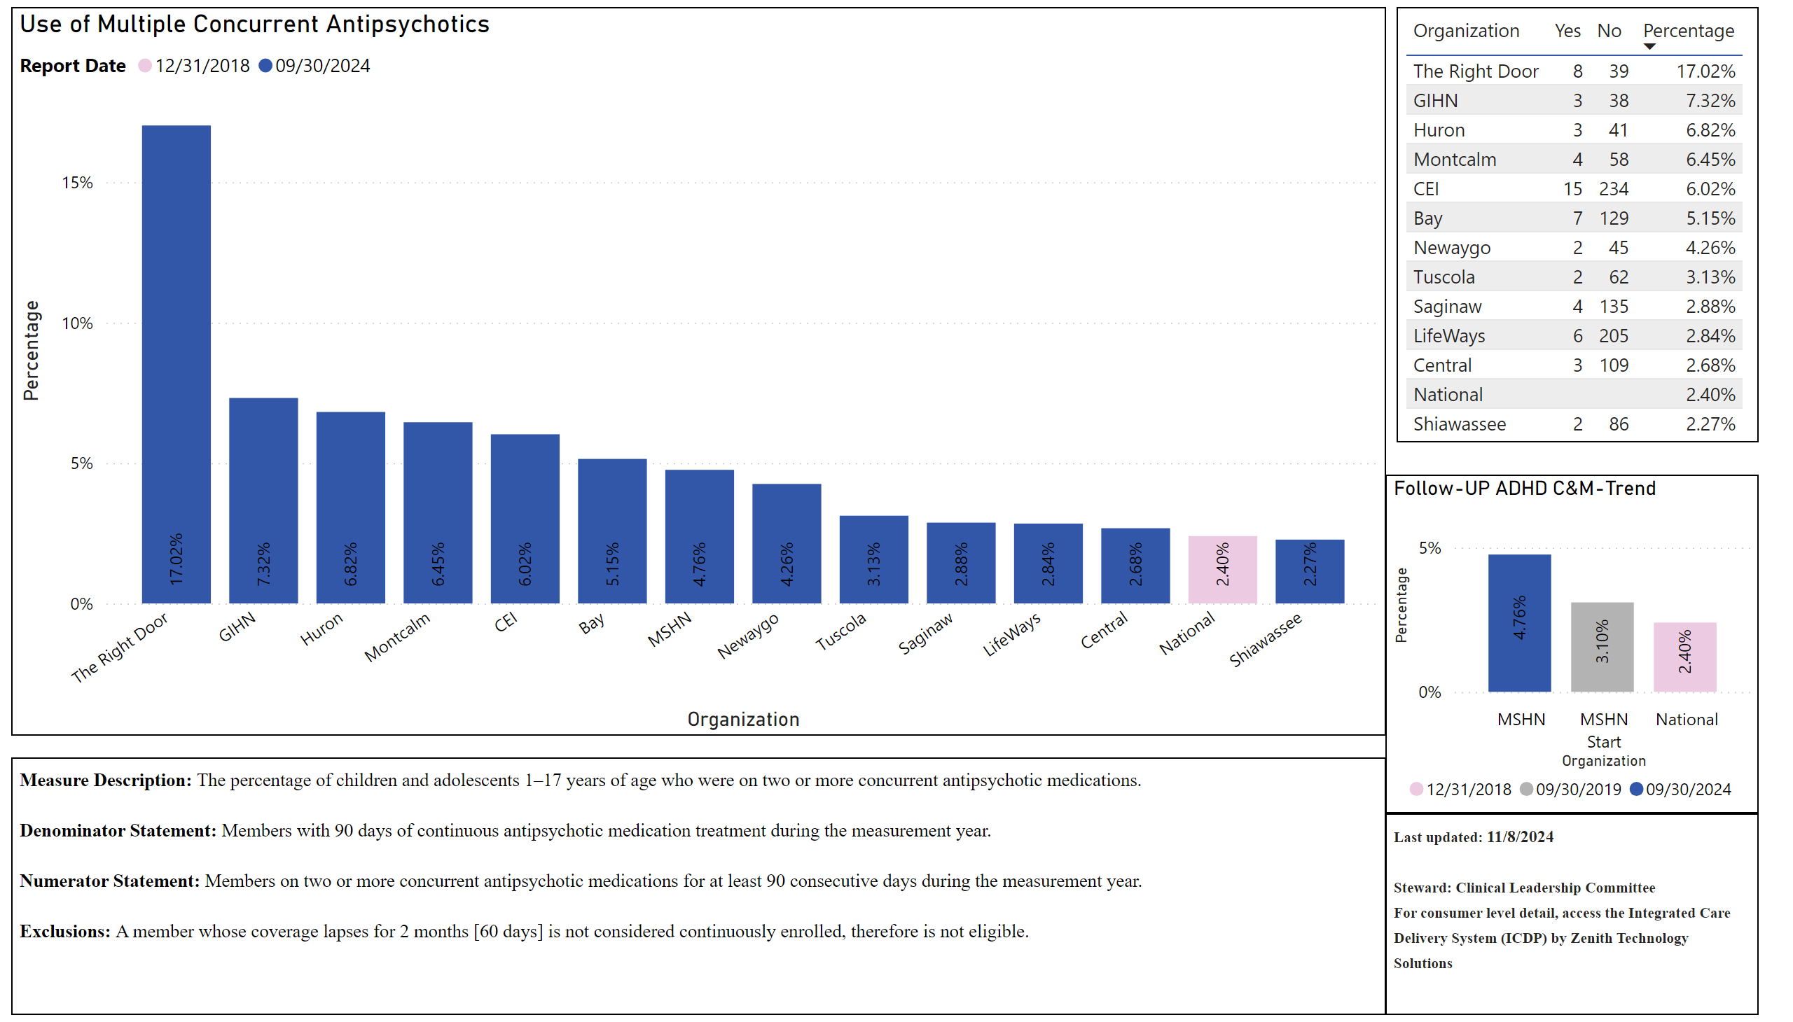
Use of Multiple Concurrent Antipsychotics
Notes:
Use of Multiple Concurrent Antipsychotics
No alt text provided
tableEx
No alt text provided
Follow-UP ADHD C&M-Trend
No alt text provided
textbox
No alt text provided
textbox
No alt text provided

Slide 12
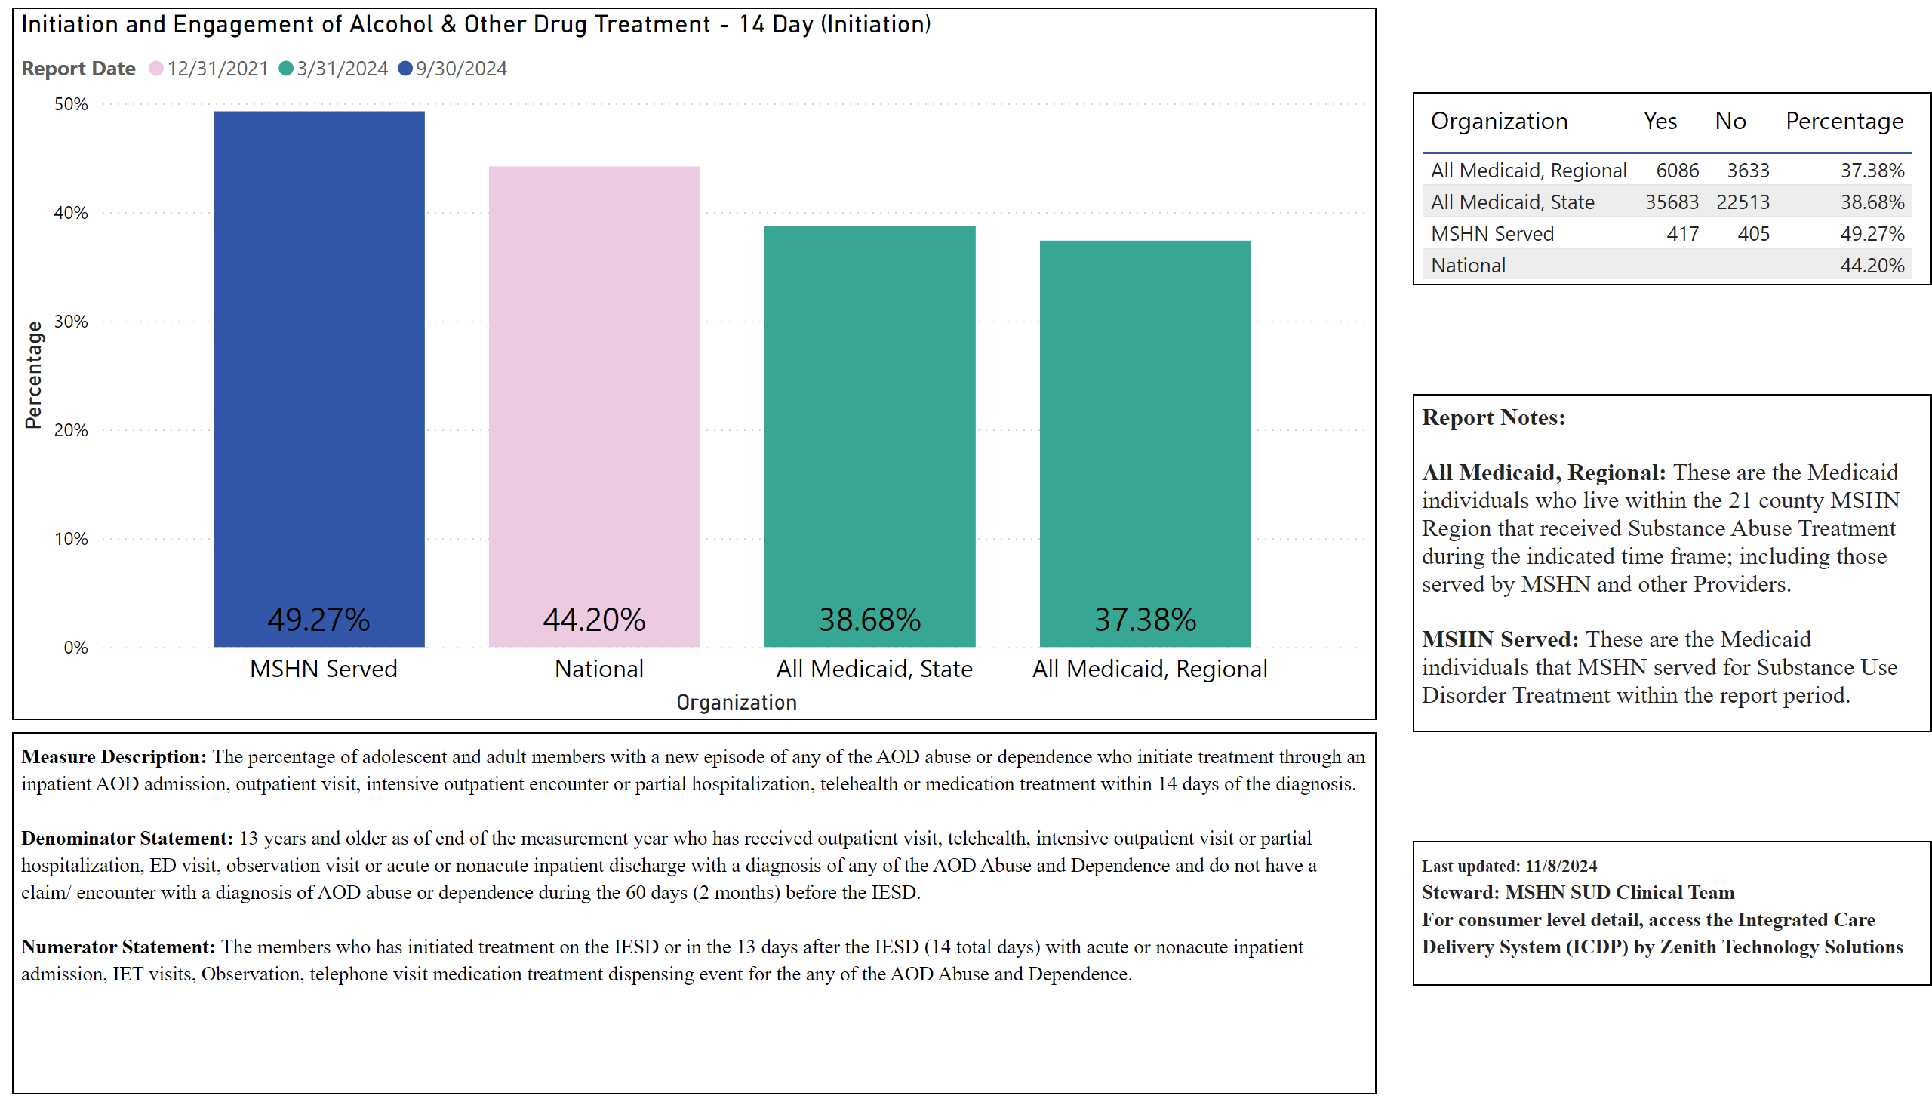
Initiation and Engagement of Alcohol & Other Drug Treatment - 14 Day
Notes:
Initiation and Engagement of Alcohol & Other Drug Treatment - 14 Day (Initiation)
No alt text provided
textbox
No alt text provided
tableEx
No alt text provided
textbox
No alt text provided
textbox
No alt text provided

Slide 13
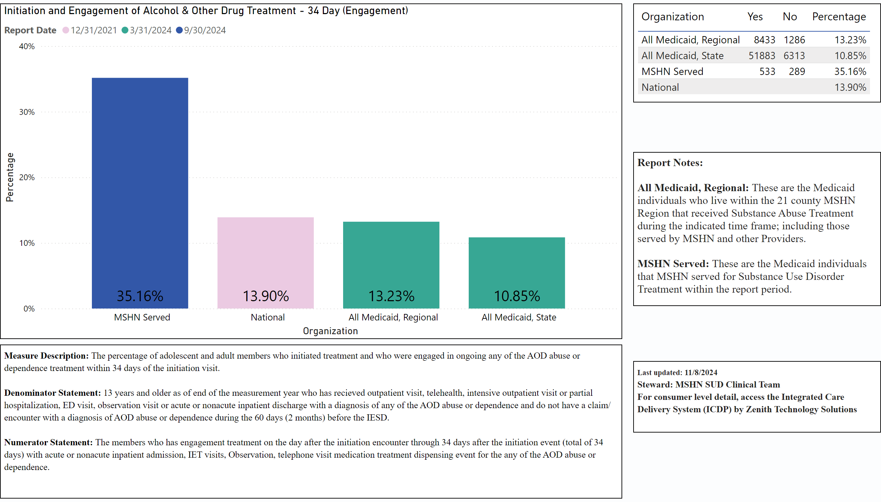
Initiation and Engagement of Alcohol & Other Drug Treatment - 34 Day
Notes:
Initiation and Engagement of Alcohol & Other Drug Treatment - 34 Day (Engagement)
No alt text provided
textbox
No alt text provided
tableEx
No alt text provided
textbox
No alt text provided
textbox
No alt text provided

